Slide 1
Exploratory Data Analysis
Jaya Sil

Slide 2
Introduction
Every time we start exploring a new dataset, we need to first do an Exploratory Data Analysis (EDA) in order to get a feeling of what are the main characteristics of certain features.
If we are able to understand presence of any pattern in the data distribution, we can then tailor-made our models to best fit our case study.
Models are designed to work best under some distribution assumptions.
Every time we are working with a dataset, our dataset represent a sample from a population.

Slide 3
Introduction
In statistics, EDA is an approach to analyzing the data sets to summarize their main characteristics, often with visual methods.
EDA is used for seeing what the data can tell us before the modeling task.
It is not easy to look at the columns or the whole spreadsheet and determine important characteristics of the data.
EDA techniques have been devised as an aid in this situation.

Slide 4
Introduction
Three popular data analysis approaches are:
(i). Classical (ii) Exploratory (EDA) (iii). Bayesian
For classical analysis, the sequence is
Problem => Data => Model => Analysis => Conclusions
For EDA, the sequence is
Problem => Data => Analysis => Model => Conclusions
For Bayesian, the sequence is
Problem => Data => Model => Prior Distribution => Analysis
=> Conclusions

Slide 5
For classical analysis, the data collection is followed by the imposition of a model and the analysis, estimation, and testing based on the parameters of that model.
For EDA, the data collection is followed immediately by analysis with a goal of inferring what model would be appropriate.
For a Bayesian analysis, the prior distribution (knowledge) on the parameters and the collected data jointly make inferences and/or test assumptions about the model parameters.
In the real world, data analysts freely mix elements of all of the above three approaches (and other approaches).

Slide 6
Statistical Inference
The main purpose of Statistics is to make an accurate conclusion about some unknown aspect of a population using a limited sample about the population.
Preliminary conclusions may be drawn by the use of EDA but formal statistical inference is based on probability theory to substantiate those conclusions.
Statistical inference is important in order to analyze data for solving nondeterministic problems.
Statistical inference can be divided into two areas: estimation and hypothesis testing.

Slide 7
Statistical inference
Inferential statistical analysis infers properties of a population by testing hypotheses and deriving estimates.
For example, you might survey a representation of people in a region and, using statistical principles including simulation and probability theory, make certain inferences based on that sample.
Statistical Inference
Population
Sample

Slide 8
Estimates and Parameters
Population-The universe to which we want to generalize.
In the population we have parameters- the true unknown values we want to estimate.
Sample- The study that we perform.
From the sample we obtain estimates of these parameters, ie. Our best guess of the population parameters.

Slide 9
Point Estimates and Parameters
An estimate of a population parameter may be expressed as: Point estimate.
A point estimate of a population parameter is a single value of a statistic.
For example, the sample mean x is a point estimate of the population mean μ.
Point estimators are functions that are used to find an approximate value of a population parameter from random samples of the population.

Slide 10
Z-score
A Z-score is a numerical measurement that describes a value's relationship to the mean of a group of values.
Z-score is measured in terms of standard deviations from the mean.
If a Z-score is 0, it indicates that the data point's score is identical to the mean score.
A Z-score of 1.0 would indicate a value that is one standard deviation from the mean.
Z-scores may be positive or negative, with a positive value indicating the score is above the mean and a negative score indicating it is below the mean.

Slide 11
Z-score
In finance, Z-scores are measures of an observation's variability and can be used by traders to help determine market volatility.
A Z-score can reveal to a trader if a value is typical for a specified data set or if it is atypical.
In general, a Z-score below 1.8 suggests a company might be headed for bankruptcy, while a score closer to 3 suggests a company is in solid financial positioning.

Slide 12
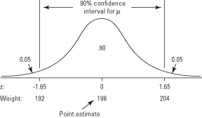
The sample mean x is an unbiased estimate of the population mean μ. Another way to say this is that x is the best point estimate of the true value of μ.
The true population mean may be larger or smaller than the sample mean.
Instead of a point estimate, you might want to identify a range of possible values, controlling the probability that μ is not lower than the lowest value in this range and not higher than the highest value. Such a range is called a confidence interval.

Slide 13
Confidence interval
The weight values for the lower and upper ends of the confidence interval are 192 and 204 (see Figure).
A confidence interval is usually expressed by two values enclosed by parentheses, as in (192, 204).
Another way to express the confidence interval is as the point estimate plus or minus a margin of error; in this case, it is 198 ± 6 pounds.
You are 90 percent certain that the true population mean of football player weights is between 192 and 204 pounds.

Slide 14
Characteristics
The higher the percentage of confidence desired, the wider the confidence interval.
The larger the standard error, the wider the confidence interval.
The larger the n, the smaller the standard error, and so the narrower the confidence interval.
All other things being equal, a smaller confidence interval is always more desirable than a larger one because a smaller interval means the population parameter can be estimated more accurately.

Slide 15
Purpose
The purpose of statistical inference is to estimate sample to sample variation or uncertainty.
Understanding how much our results may differ if we did the study again, or how uncertain our findings are, allows us to take this uncertainty into account when drawing conclusions.
It allows us to provide a plausible range of values for the true value of something in the population, such as the mean, or size of an effect.
It allows us to make statements about whether our study provides evidence to reject a hypothesis.

Slide 16
Hypothesis
A hypothesis is an idea which is suggested as a possible explanation for a particular situation or condition, but which has not yet been proved to be correct.
It should be testable, either by experiment or observation.
Hypothesis testing, where a specific statement or hypothesis is generated about a population parameter.
Sample statistics are used to assess the likelihood that the hypothesis is true.
The hypothesis is based on available information.
Hypothesis testing is an act in statistics whereby an analyst tests an assumption regarding a population parameter.

Slide 17
Hypothesis testing
The methodology employed by the analyst depends on the nature of the data used and the reason for the analysis.
Hypothesis testing is used to assess the plausibility of a hypothesis by using sample data.
Such data may come from a larger population, or from a data-generating process.
Statistical analysts test a hypothesis by measuring and examining a random sample of the population being analyzed.

Slide 18
Null Hypothesis
The statistical hypothesis is called the null hypothesis and is typically stated as no effect or no difference.
The null hypothesis, H₀ is the commonly accepted fact; it is the opposite of the alternate hypothesis.
Researchers work to reject, nullify or disprove the null hypothesis.
Researchers come up with an alternate hypothesis, one that they think explains a phenomenon, and then work to reject the null hypothesis.

Slide 19
The p-value
A hypothesis test asks the question, could the difference we observed in our study be due to chance?
We can never prove a hypothesis, only falsify it, or fail to find evidence against it.
You can see a hypothesis test as a way of quantifying the evidence against the null hypothesis.
Including both a null and an alternate hypothesis is one safeguard to ensure your research isn’t flawed.
The evidence against the null hypothesis is estimated based on the sample data and expressed using a probability (p-value).

Slide 20
The p-value
In statistics, the p-value is the probability of obtaining results at least as extreme as the observed results of a statistical hypothesis test, assuming that the null hypothesis is correct.
The p-value is used as an alternative to rejection points to provide the smallest level of significance at which the null hypothesis would be rejected.
A smaller p-value means that there is stronger evidence in favor of the alternative hypothesis.

Slide 21
The p-values
p-values are usually found using p-value tables or spreadsheets/statistical software.
These calculations are based on the assumed or known probability distribution of the specific statistic being tested.
p-values are calculated from the deviation between the observed value and a chosen reference value.
Given the probability distribution of the statistic, with a greater difference between the two values corresponding to a lower p-value.

Slide 22
The p-values
In practice, the significance level is stated in advance to determine how small the p-value must be in order to reject the null hypothesis.
Because different researchers use different levels of significance when examining a question.
A reader may sometimes have difficulty comparing results from two different tests.
p-values provide a solution to this problem.

Slide 23
The p value
A p value is used in hypothesis testing to help you support or reject the null hypothesis.
The p value is the evidence against a null hypothesis. The smaller the p-value, the stronger the evidence that you should reject the null hypothesis.
Both Alternate and null hypothesis together cover all the possible values of the population parameter.
More specifically, we compare the p-value to a significance level alpha (α) to make conclusions about our hypotheses.
p-value < α ➔reject H₀ (null hypothesis) ➔ accept H_{a}
p-value ≥ α ➔ fail to reject H₀ (null hypothesis)

Slide 24
Example 1
A soap company claims that its product kills on an average of 99% of the germs. To test the claim of this company we will formulate the null and alternate hypothesis.
Null Hypothesis(H₀): Average =99%
Alternate Hypothesis(H₁): Average is not equal to 99%.
When we test a hypothesis, we assume the null hypothesis to be true until there is sufficient evidence in the sample to prove it false. In that case, we reject the null hypothesis and support the alternate hypothesis. If the sample fails to provide sufficient evidence for us to reject the null hypothesis, we cannot say that the null hypothesis is true because it is based on just the sample data. For saying the null hypothesis is true we will have to study the whole population data.

Slide 25
Alpha levels are controlled by the researcher and are related to confidence levels.
You get an alpha level by subtracting your confidence level from 100%.
For example, if you want to be 98 percent confident in your research, the alpha level would be 2% (100% – 98%).
When you run the hypothesis test, the test will give you a value for p.

Slide 26
Compare that value to your chosen alpha level. For example, let’s say you chose an alpha level of 5% (0.05). If the results from the test give you:
A small p (≤ 0.05), reject the null hypothesis. This is strong evidence that the null hypothesis is invalid.
A large p (> 0.05) means the alternate hypothesis is weak, so you do not reject the null.

Slide 27
In an ideal world, you’ll have an alpha level.
But if you do not, you can still use the following rough guidelines in deciding whether to support or reject the null hypothesis:
If p > .10 → “not significant”
If p ≤ .10 → “marginally significant”
If p ≤ .05 → “significant”
If p ≤ .01 → “highly significant.”

Slide 28
Four steps involved in using the p-value approach to conducting any hypothesis test are:
Specify the null and alternative hypotheses.
Using the sample data and assuming the null hypothesis is true, calculate the value of the test statistic. Again, to conduct the hypothesis test for the population mean μ, we use the t-statistic which follows a t-distribution with n - 1 degrees of freedom.

Slide 29
Using the known distribution of the test statistic, calculate the P-value: "If the null hypothesis is true, what is the probability that we'd observe a more extreme test statistic in the direction of the alternative hypothesis than we did?" (Note how this question is equivalent to the question answered in criminal trials: "If the defendant is innocent, what is the chance that we'd observe such extreme criminal evidence?")
Set the significance level, α, the probability of making a Type I error to be small — 0.01, 0.05, or 0.10. Compare the P-value to α. If the P-value is less than (or equal to) α, reject the null hypothesis in favor of the alternative hypothesis. If the P-value is greater than α, do not reject the null hypothesis.

Slide 30
Statistical significance
For example, suppose a study comparing returns from two particular assets were undertaken by different researchers who used the same data but different significance levels.
The researchers might come to opposite conclusions regarding whether the assets differ.
If one researcher used a confidence level of 90% and the other required a confidence level of 95% to reject the null hypothesis and the p-value of the observed difference between the two returns was 0.08 (corresponding to a confidence level of 92%).
The first researcher would find that the two assets have a difference that is statistically significant, while the second would find no statistically significant difference between the returns.

Slide 31
Statistical significance
To avoid this problem, the researchers could report the p-value of the hypothesis test and allow the reader to interpret the statistical significance themselves.
A p-value is the probability of getting a result more extreme than was observed if the null hypothesis is true. This is called a p-value approach to hypothesis testing.
An independent observer could note the p-value, and decide whether that represents a statistically significant difference or not.

Slide 32
Statistical significance
If p=0.04, it is correct to say "the chance (or probability) of getting a result more extreme than the one we observed is 4% if the null hypothesis is true.
It is not correct to say "there's a 4% chance that the null hypothesis is true". The hypothesis is fixed and the data (from the sample) are random, so the hypothesis is either true or it isn't true, it has no probability other than 0 (not true) or 1 (true).
Like with confidence intervals, understanding this will means you have reached a milestone of understanding of statistical concepts.

Slide 33

Hypothesis testing chi-square
The Chi Square statistic is commonly used for testing relationships between categorical variables.
The null hypothesis of the Chi-Square test is that no relationship exists on the categorical variables in the population; they are independent.
The chi square formula
The chi-squared statistic is a single number that tells you how much difference exists between your observed counts and the counts you would expect if there were no relationship at all in the population.

Slide 34
The Chi Square test
A low value for chi-square means there is a high correlation between your two sets of data.
In theory, if your observed and expected values were equal (“no difference”) then chi-square would be zero — an event that is unlikely to happen in real life.
We could take the calculated chi-square value and compare it to a critical value from a chi-square table. If the chi-square value is more than the critical value, then there is a significant difference.

Slide 35
The Chi-square test
A chi-square test can be used to test if the variance of a population is equal to a specified value.
This test can be either a two-sided test or a one-sided test.
The two-sided version tests against the alternative that the true variance is either less than or greater than the specified value.
The one-sided version only tests in one direction.
The choice of a two-sided or one-sided test is determined by the problem.
For example, if we are testing a new process, we may only be concerned if its variability is greater than the variability of the current process.

Slide 36
Summary-statistical inference
All point estimates (statistics calculated from the sample data) are subject to sampling variation, and all methods of statistical inference seek to quantify this uncertainty in some way.
The ideas of a confidence interval and hypothesis form the basis of quantifying uncertainty.
The probability distribution of a statistic is actually the sampling distribution.
Much of the critical appraisal of the methodology of a study can be seen as a special case of evaluating bias or precision.

Slide 37
Focus and Techniques of Data Analysis
For classical analysis, the focus is on the model--estimating parameters of the model and generating predicted values from the model.
For EDA, the focus is on the data--its structure, outliers, and models suggested by the data.
Classical techniques are generally quantitative in nature. They include ANOVA, t tests, chi-squared tests, and F tests.
EDA techniques are generally graphical. They include scatter plots, character plots, box plots, histograms, bihistograms, probability plots, residual plots, and mean plots.

Slide 38
EDA Techniques
After you have collected a set of data, how do you do an exploratory data analysis?
What techniques do you employ?
What do the various techniques focus on?
What conclusions can you expect to reach?
The techniques are divided into graphical and quantitative techniques.
For exploratory data analysis, the emphasis is primarily on the graphical techniques.

Slide 39
Autocorrelation plots
Autocorrelation plots are a commonly-used tool for checking randomness in a data set.
This randomness is ascertained by computing autocorrelations for data values at varying time lags.
If random, such autocorrelations should be near zero for any and all time-lag separations.
If non-random, then one or more of the autocorrelations will be significantly non- zero.

Slide 40
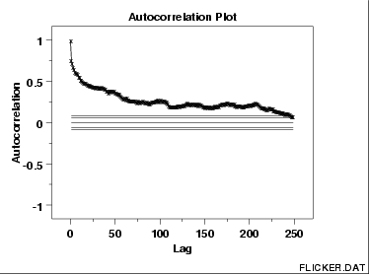
This sample autocorrelation plot of the FLICKER.DAT data set shows that the time series is not random, but rather has a high degree of autocorrelation between adjacent and near-adjacent observations.

Slide 41
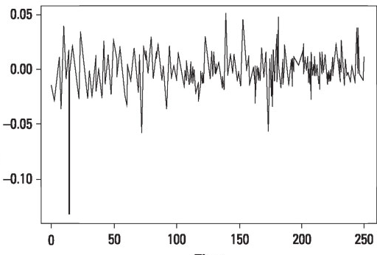
Autocorrelation

Slide 42
Data Types
Using this sample, we can then try to understand it’s main patterns so that we can use it to make predictions on the whole population
Datasets are composed of two main types of data: Numerical (eg. integers, floats), and Categorical (eg. names, laptops brands).
Numerical data can additionally be divided into other two categories: Discrete and Continue.
Discrete data can take only certain values (eg. number of students in a school) while continuous data can take any real or fractional value (eg. the concepts of height and weights).

Slide 43
Probability Distributions in Data Science
From discrete random variables, it is possible to calculate Probability Mass Functions, while from continuous random variables can be derived Probability Density Functions.
Probability Mass Functions gives the probability that a variable can be equal to a certain value.
The values of Probability Density Functions are not itself probabilities because they need first to be integrated over the given range.

Slide 44
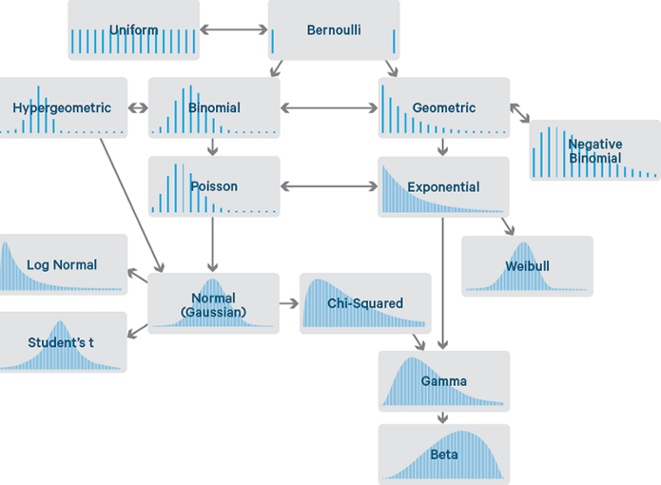
Different probability distributions

Slide 45
Bernoulli Distribution
The Bernoulli distribution is used as a starting point to derive more complex distributions.
This distribution has only two possible outcomes and a single trial.
The probability that the outcome might be heads can be considered equal to p and (1 - p) for tails in case of tossing a coin.
The probabilities of mutually exclusive events that encompass all possible outcomes needs to sum up to one.

Slide 46
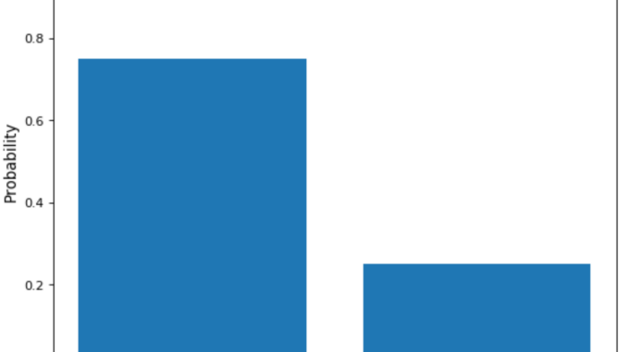
Bernoulli distribution of a biased coin

Slide 47
Uniform Distribution
The Uniform Distribution can be easily derived from the Bernoulli Distribution.
In this case, a possibly unlimited number of outcomes are allowed and all the events hold the same probability to take place.
As an example, imagine the roll of a fair dice.
There are multiple possible events with each of them having the same probability to happen.

Slide 48
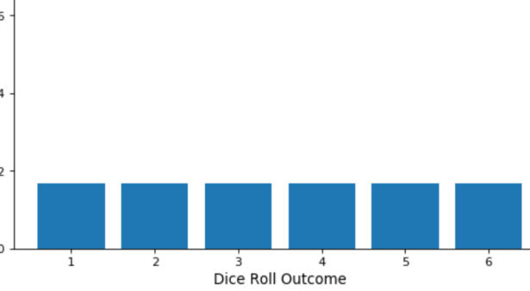

Slide 49
Binomial Distribution
The Binomial Distribution can be thought as the sum of outcomes of an event following a Bernoulli distribution.
The Binomial Distribution is therefore used in binary outcome events and the probability of success and failure is the same in all the successive trials.
This distribution takes two parameters as inputs: the number of times an event takes place and the probability assigned to one of the two classes.
A simple example of a Binomial Distribution in action can be the toss of a biased/unbiased coin repeated a certain amount of times.

Slide 50
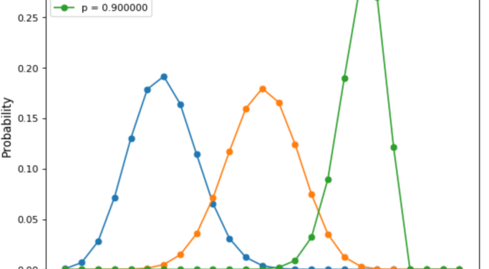
Binomial Distribution varying event occurrence probability

Slide 51
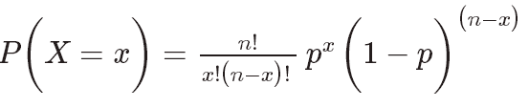
Binomial Distribution
The main characteristics of a Binomial Distribution are:
Given multiple trials, each of them is independent of each other (the outcome of one trial doesn’t affect another one).
Each trial can lead to just two possible results (eg. winning or losing), which have probabilities p and (1 - p).
If we are given the probability of success (p) and the number of trials (n), we can then be able to calculate the probability of success (x) within these n trials using the formula

Slide 52
Normal Distribution
The Normal Distribution is one of the most used distributions in Data Science.
“In probability theory, the central limit theorem (CLT) establishes that, in some situations, when independent random variables are added, their properly normalized sum tends toward a normal distribution even if the original variables themselves are not normally distributed.”

Slide 53
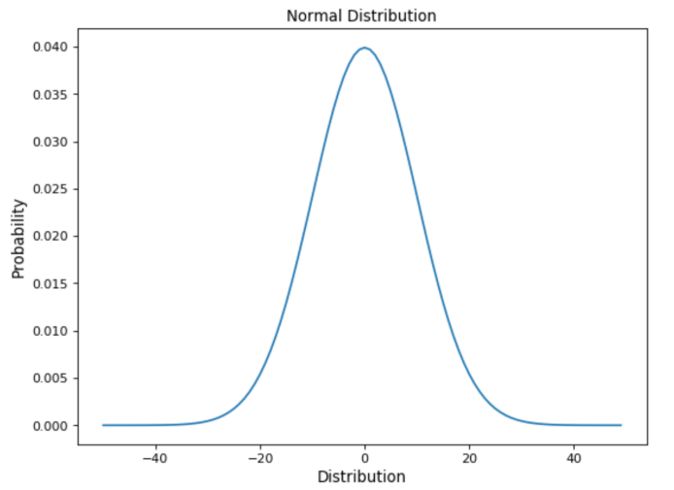

Slide 54
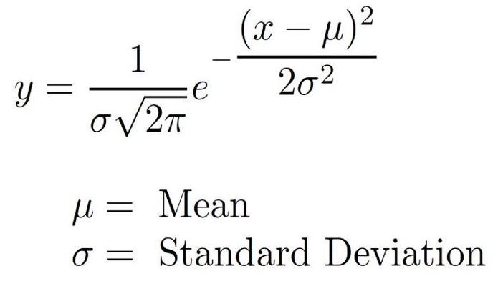
Normal distribution
Characteristics to recognise a normal distribution are:
The curve is symmetric at the centre. Therefore mean, mode and median are all equal to the same value, making distribute all the values symmetrically around the mean.
The area under the distribution curve is equal to 1 (all the probabilities must sum up to 1).

Slide 55
Poisson Distributions
Poisson Distributions are commonly used to find the probability that an event might happen or not knowing how often it usually occurs.
Additionally, Poisson Distributions can also be used to predict how many times an event might occur in a given time period.
Poisson Distributions are frequently used by insurance companies to conduct risk analysis (eg. predict the number of car crash accidents within a predefined time span) to decide car insurance pricing.

Slide 56
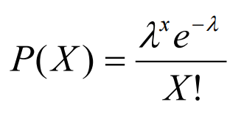
where λ represents the expected number of events which can take place in a period.
When working with Poisson Distributions, we can be confident of the average time between the occurrence of different events, but the precise moment an event might take place is randomly spaced in time.

Slide 57
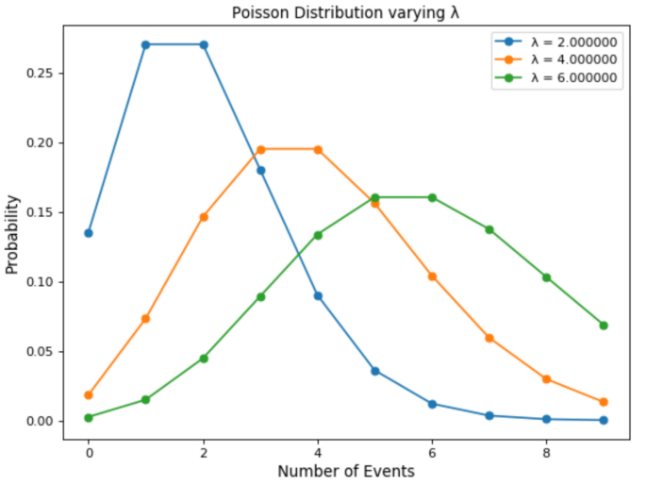

Slide 58
Poisson Processes
The main characteristics which describe Poisson Processes are:
The events are independent of each other (if an event happens, this does not alter the probability that another event can take place).
An event can take place any number of times (within the defined time period).
Two events can’t take place simultaneously.
The average rate between events occurrence is constant.

Slide 59
Exponential Distribution
The Exponential Distribution is used to model the time taken between the occurrence of different events.
As an example, let’s imagine we work at a restaurant and we want to predict what is going to be the time interval between different customers coming to the restaurant.
Using an Exponential Distribution for this type of problem, could be the perfect place where to start.
Another common application of Exponential distributions is survival analysis (eg. expected life of a device/machine).

Slide 60
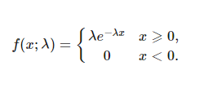
Exponential distributions
Exponential distributions are regulated by a parameter λ. The greater the value of λ and the faster the exponential curve is going to decay.

Slide 61
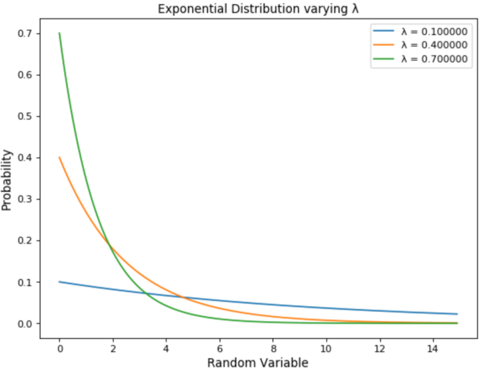

Slide 62
Deterministic and Stochastic processes
In a deterministic process, if we know the initial condition (starting point) of a series of events we can then predict the next step in the series.
Instead, in stochastic processes, if we know the initial condition, we can’t determine with full confidence what are going to be the next steps.
There are many (or infinite!) different ways the stochastic process might evolve.
In deterministic processes, all the subsequent steps are known with a probability of 1.
In stochastic processes, each individual event is random, although hidden patterns which connect each of these events can be identified.

Slide 63
Stochastic processes
In stochastic processes, each individual event is random, although hidden patterns which connect each of these events can be identified.
In order to describe stochastic processes in statistical terms, we can give the following definitions:
Observation: the result of one trial.
Population: all the possible observation that can be registered from a trial.
Sample: a set of results collected from separated independent trials.
For example, the toss of a fair coin is a random process, but thanks to The Law of the Large Numbers we know that given a large number of trials we will get approximately the same number of heads and tails.

Slide 64
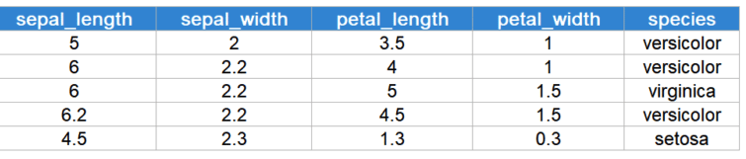
Exploratory Data Analysis
EDA is generally cross-classified in two ways.
First, each method is either non-graphical or graphical.
Second, each method is either univariate or multivariate (usually just bivariate).
iris dataset - there are 50 instances (rows of data) of each species, a total of 150 data points.

Slide 65
Exploratory Data Analysis
Non-graphical methods generally involve calculation of summary statistics, while graphical methods obviously summarize the data in a diagrammatic or pictorial way.
EDA emphasizes graphical techniques while classical techniques emphasize quantitative techniques. In practice, an analyst typically uses a mixture of graphical and quantitative techniques.
Univariate methods look at one variable (data column) at a time, while multivariate methods look at two or more variables at a time to explore relationships.
It is almost always a good idea to perform univariate EDA on each of the components of a multivariate EDA before performing the multivariate EDA.

Slide 66
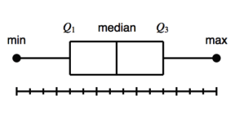
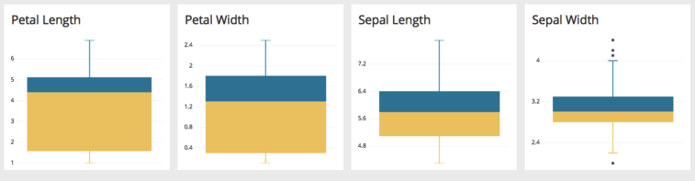
The Box Plots
A box and whisker plot – also called a box plot – displays the five-number summary of a set of data.
The five-number summary is the minimum, first quartile, median, third quartile, and maximum.

Slide 67
The Box Plots
The box plots provide us with the summary of the four numerical features in the dataset.
We can observe that the distribution of petal length and width is more spread out, as exhibited by the bigger size of the boxes.
The sepal length and width is concentrated around it’s median.
Moreover, in the sepal width box plot, we can observe a few outliers, as shown by the dots above and below the whisker.

Slide 68
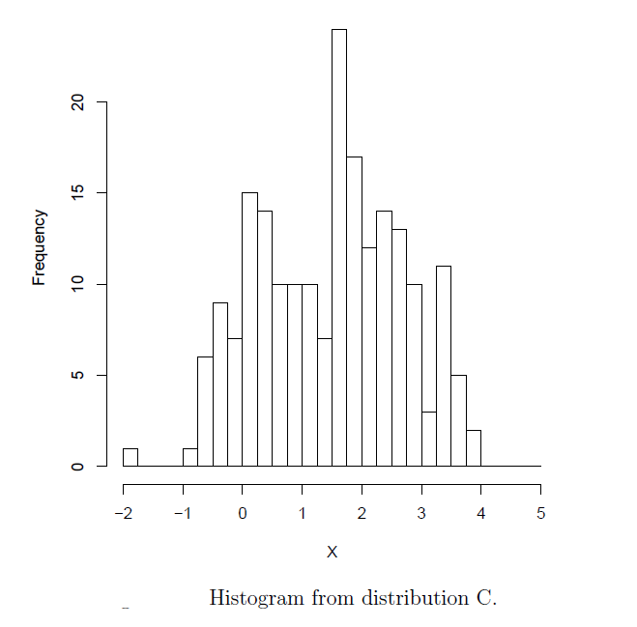
Histogram
A histogram is a plot that lets you discover, and show, the underlying frequency distribution (shape) of a set of continuous data.

Slide 69
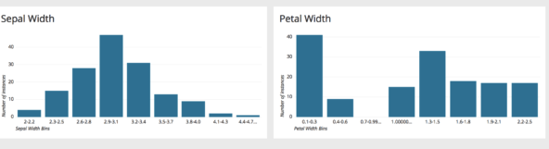
Histogram
The histogram of sepal and petal widths made in Chartio. From the charts it can be observed that the sepal width follows a Gaussian distribution.
However, petal width is more skewed towards the right, and the majority of the flower samples have a petal width less than 0.4 cm.

Slide 70
Univariate non-graphical EDA
The data that come from making a particular measurement on all of the subjects in a sample, represent observations for a single characteristic such as age, gender, speed at a task, or response to a stimulus.
We should think of these measurements as representing a “sample distribution” of the variable.
The usual goal of univariate non-graphical EDA is to better appreciate the “sample distribution”.
What we observe in the sample of measurements for a particular variable that we select for our particular experiment is the “sample distribution”.
Outlier detection is also a part of this analysis.

Slide 71
Categorical Data
The characteristics of interest for a categorical variable are simply the range of values and the frequency (or relative frequency) of occurrence for each value.
A simple tabulation of the frequency of each category is the best univariate non-graphical EDA for categorical data.
Statistic/College | H&SS | MCS | SCS | Other | Total
count | 5 | 6 | 4 | 5 | 20
proportion | 0.25 | 0.30 | 0.20 | 0.25 | 100
Percentage | 25% | 30% | 20% | 25% | 100%
Losing data is a common mistake, and EDA is helpful for finding mistakes.

Slide 72
Characteristics of quantitative data
Univariate EDA for a quantitative variable is a way to make preliminary assessments about the population distribution of the variable using the data of the observed sample.
The characteristics of the population distribution of a quantitative variable are its center, spread, modality (number of peaks in the pdf), shape (including “heaviness of the tails”), and outliers.
The characteristics of our randomly observed sample are not inherently interesting, except to the degree that they represent the population that it came from.

Slide 73
What we observe in the sample of measurements for a particular variable that we select for our particular experiment is the “sample distribution".
We need to recognize that each time we might repeat the same experiment, our observation is different due to selection of a different random sample, a different treatment randomization, and different random (incompletely controlled) experimental conditions.
In addition we can calculate “sample statistics" from the data, such as sample mean, sample variance, sample standard deviation, sample skewness and sample kurtosis.
These again would vary for each repetition of the experiment, so they don't represent any deep truth, but rather represent some uncertain information about the underlying population distribution and its parameters, which are what we really care about.

Slide 74
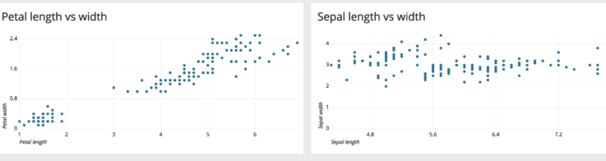
Multivariate analysis
Multivariate data analysis refers to any statistical technique used to analyze data that arises from more than one variable.
This models more realistic applications, where each situation, product, or decision involves more than a single variable.
A scatter plot is a two-dimensional data visualization that uses dots to represent the values obtained for two different variables – one along the x-axis and the other along the y-axis.

Slide 75
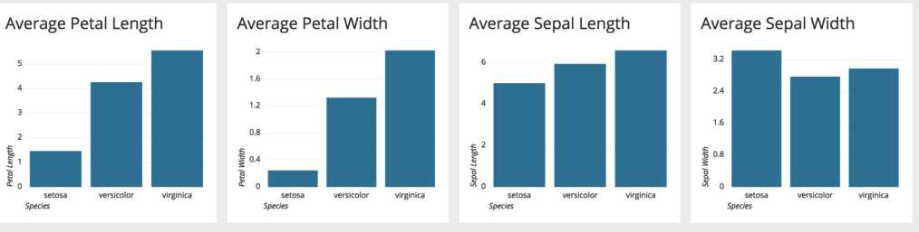
There is a linear relationship between petal length and width.
However, with increase in sepal length, the sepal width does not increase proportionally – hence they do not have a linear relationship.
A bar chart represents categorical data, with rectangular bars having lengths proportional to the values that they represent.

Slide 76
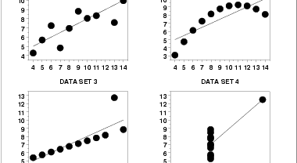
Scatter plots are used to observe relationships between the variables.

Slide 77
Summary
The exploratory data analysis we performed provides us with a good understanding of what the data contains.
Once this stage is complete, we can perform more complex modeling tasks such as clustering and classification.
EDA is valuable to the data scientist to make certain that the results they produce are valid, correctly interpreted, and applicable to the desired business contexts.
EDA is a crucial step to take before diving into machine learning or statistical modeling because it provides the context needed to develop an appropriate model for the problem at hand and to correctly interpret its results.

